Slide 1

EDA Final Project Details & Summary
Course – Exploratory Data Analysis
Course code - DSC 530
Course Schedule - Winter 2022
Teacher – Mr. Matthew Metzger
Student Name – Manish Shekhar

Slide 2
Data Set Introduction
Data Set
I have chosen countrywide traffic accident dataset, which covers 49 states of the United States. The data is continuously being collected from February 2016, using several data providers, including multiple APIs that provide streaming traffic event data. These APIs broadcast traffic events captured by a variety of entities, such as the US and state departments of transportation, law enforcement agencies, traffic cameras, and traffic sensors within the road-networks. Currently, there are about 1.5 million accident records in this dataset.
EDA Study inspiration
US-Accidents can be used for numerous applications such as car accident prediction, studying car accidents hotspot locations, casualty analysis and extracting cause and effect rules to predict car accidents, and studying the impact of precipitation, temperature, windspeed or other environmental stimuli on accident occurrence. Seasonality can be also looked at while considering COVID-19 lock downs etc.
Data Set Location
Kaggle - https://www.kaggle.com/datasets/sobhanmoosavi/us-accidents?select=US_Accidents_Dec21_updated.csv
My Kaggle username and key to download the data file
{"username":"manishshekhar","key":"d550fc7b6f0060440a22a18b2df4a3c3"}
NOTE: Jupyter notebook will prompt for above username and key when attempting to download the data file from Kaggle.

Slide 3
Metadata of columns used in EDA
Severity (Type : Number) - Shows the severity of the accident, a number between 1 and 4, where 1 indicates the least impact on traffic (i.e., short delay as a result of the accident) and 4 indicates a significant impact on traffic (i.e., long delay).
Start_Time (Type : Date Time) - Shows start time of the accident in local time zone.
End_Time (Type : Date Time) - Shows end time of the accident in local time zone. End time here refers to when the impact of accident on traffic flow was dismissed.
Distance(mi) (Type : Number) - The length of the road extent affected by the accident.
Description (Type : String) - Shows a human provided description of the accident.
City (Type : String) - Shows the city name in address field.
County (Type : String) - Shows the county name in address field.
State (Type : String) - Shows the state name in address field.
Country (Type : String) - Shows the country name in address field. Data is for US only.
Temperature (F) (Type : Number) - Shows the temperature (in Fahrenheit).
Wind_Chill (F) (Type : Number) - Shows the wind chill (in Fahrenheit).
Pressure(in) (Type : Number) - Shows the air pressure (in inches).
Visibility(miles) (Type : Number) - Shows visibility (in miles).
Wind_Speed (Type : Number) - Shows wind speed (in miles per hour).
Precipitation(in) (Type : Number) - Shows precipitation amount in inches, if there is any.
Civil_Twilight (Type : String) - Shows the period of day (i.e., day or night) based on civil twilight.
Nautical_Twilight (Type : String) - Shows the period of day (i.e., day or night) based on nautical twilight.
Astronomical_Twilight (Type : String) - Shows the period of day (i.e., day or night) based on astronomical twilight.

Slide 4
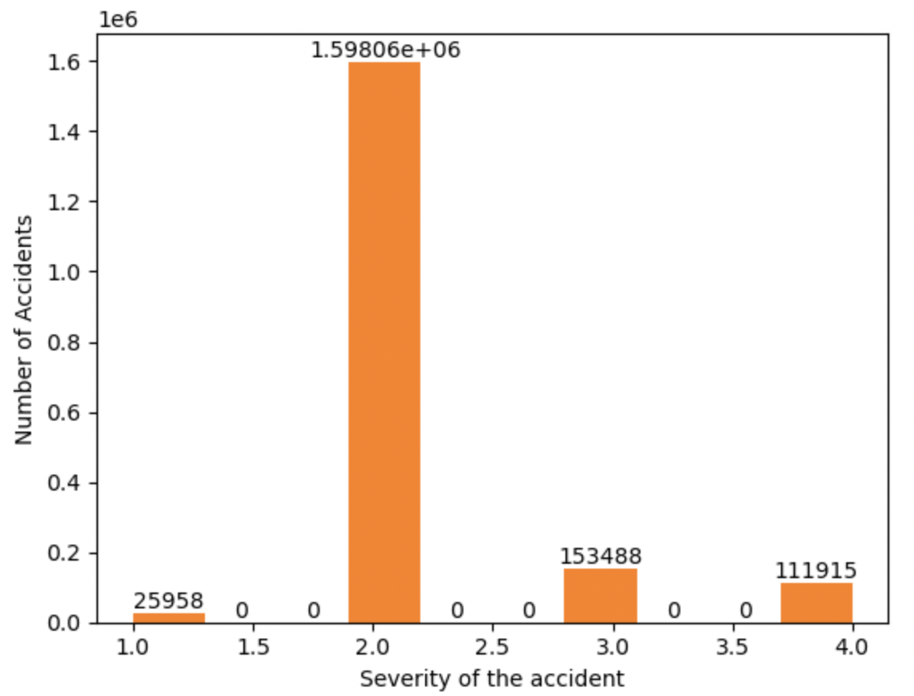
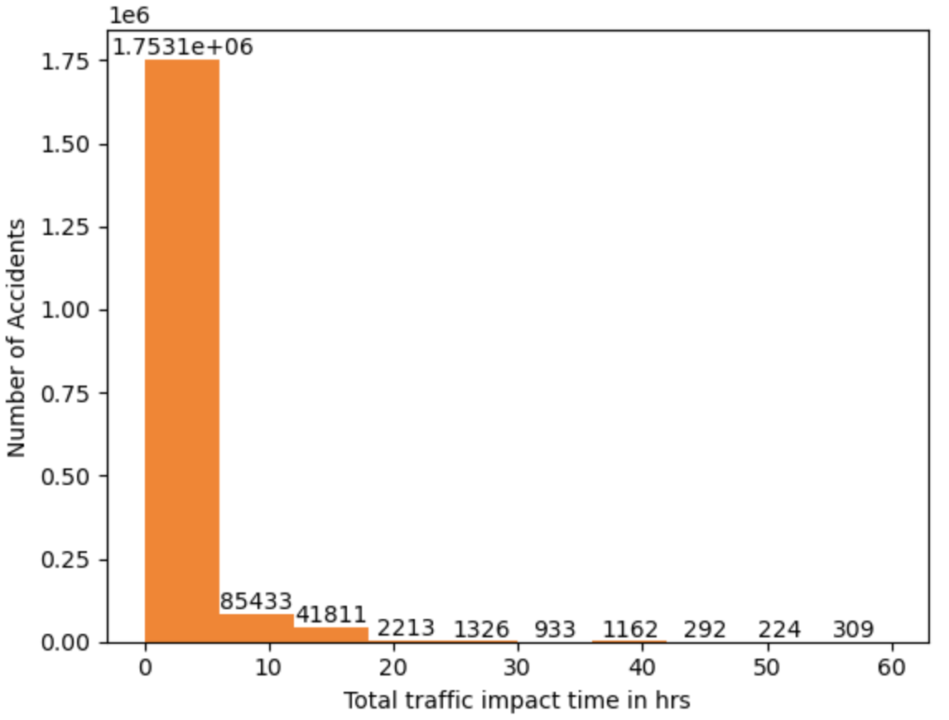
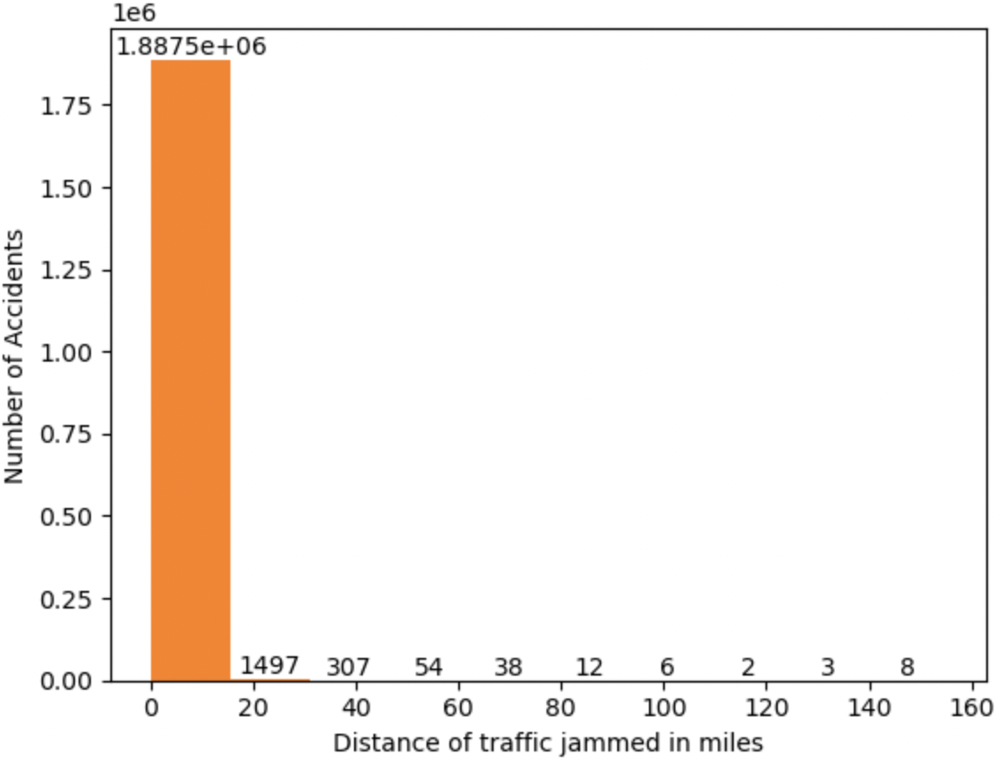
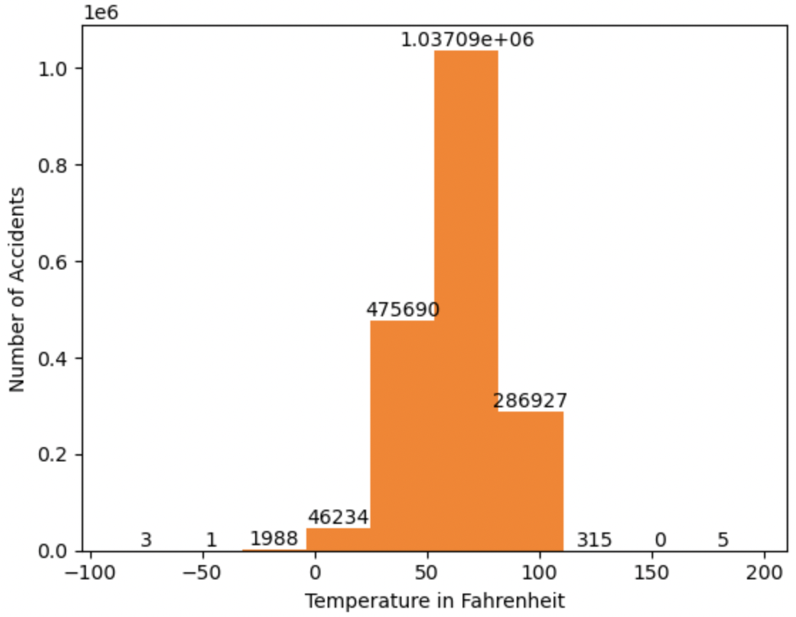
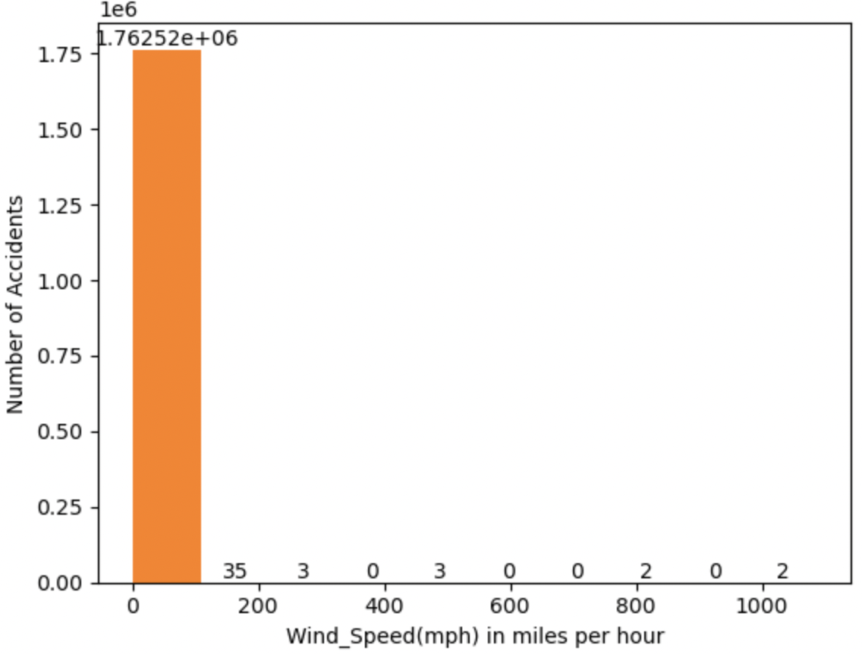
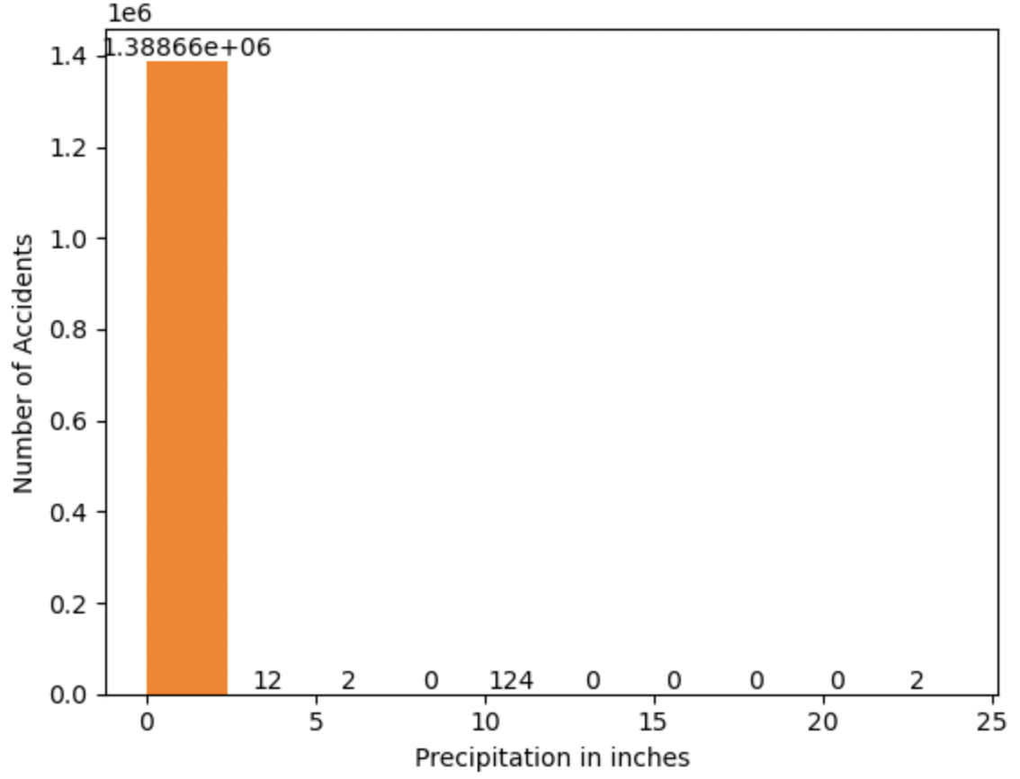
Question 1 to 4: 1. A minimum of 5 variables in your dataset used during your analysis (for help with selecting, the author made his selection on page 6 of your book). Consider what you think could have an impact on your question – remember this is never perfect, so don’t be worried if you miss one (Chapter 1). 2. Describe what the 5 variables mean in the dataset (Chapter 1). 3. Include a histogram of each of the 5 variables – in your summary and analysis, identify any outliers and explain the reasoning for them being outliers and how you believe they should be handled (Chapter 2). 4. Include the other descriptive characteristics about the variables: Mean, Mode, Spread, and Tails (Chapter 2).
Mean severity of accidents is 2.13 (right in the middle of 1-low and 4-high). 75th percentile for severity is also about 2.
Most accidents got cleared in less than 7 hrs. and thus distribution is left skewed with long right tail i.e., there are a few accidents that took longer than 7 hrs. to clear.
We can clearly see that majority of accidents impacted less that 1 mile of traffic
NOTE: I am not able to attach the detailed data profile html file generated from pandas profiling here.
I will attach it as part of the final submission. It shows data profile, data distribution for each variable in the dataset. It also shows correlation etc. useful stats between all variables.
We can see that 50% accident happened at temperature between 55 to 80 degrees Fahrenheit.
More than 80% of accidents seems to have happened at windspeed <= 11 mph
In case of 75% accidents there was no precipitation.

Slide 5
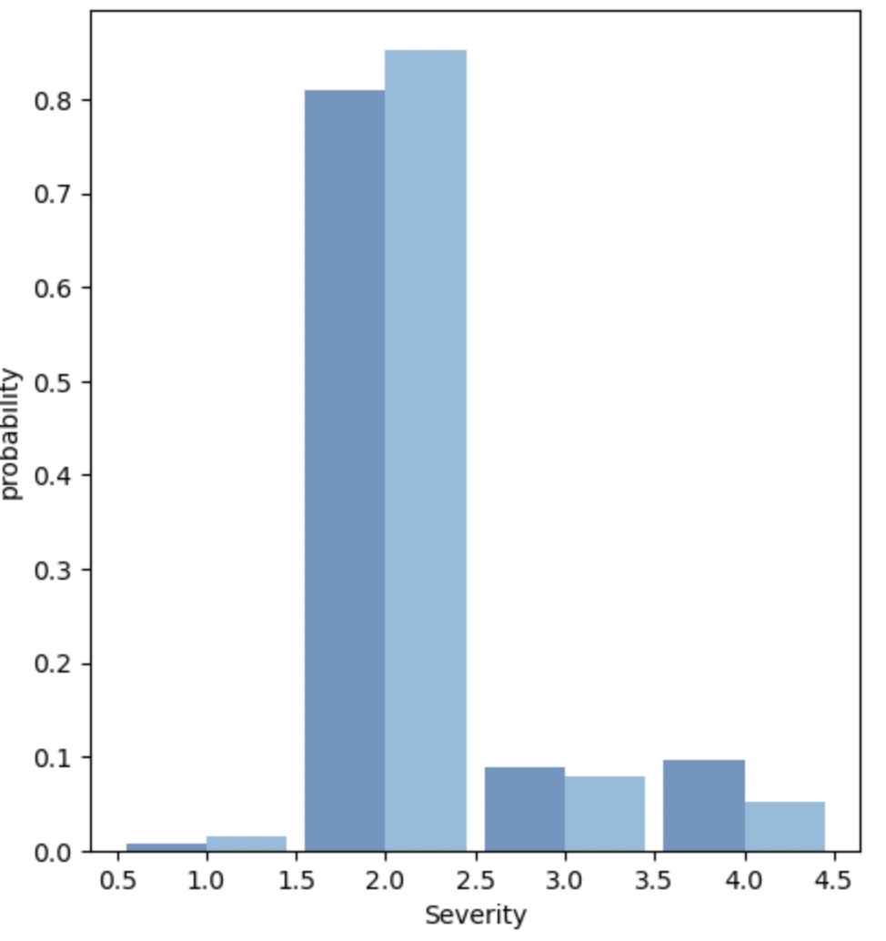
Question 5: Using pg. 29 of your text as an example, compare two scenarios in your data using a PMF. Reminder, this isn’t comparing two variables against each other – it is the same variable, but a different scenario. Almost like a filter. The example in the book is first babies compared to all other babies, it is still the same variable, but breaking the data out based on criteria we are exploring (Chapter 3).
We will compare distribution of severity of accidents by night and day. Plotting the probability mass function or pmfs of accident severity at night vs accident severity at the daytime.
Observation :
Interestingly low to medium severity accidents have slightly higher probability of occurrence during nighttime (light blue).
2. And higher severity accidents have higher probability to occur in daytime (dark blue). Severity 4 accidents have almost 10% probability of happening in daytime while only about 6% probability of them happening at the nighttime.

Slide 6
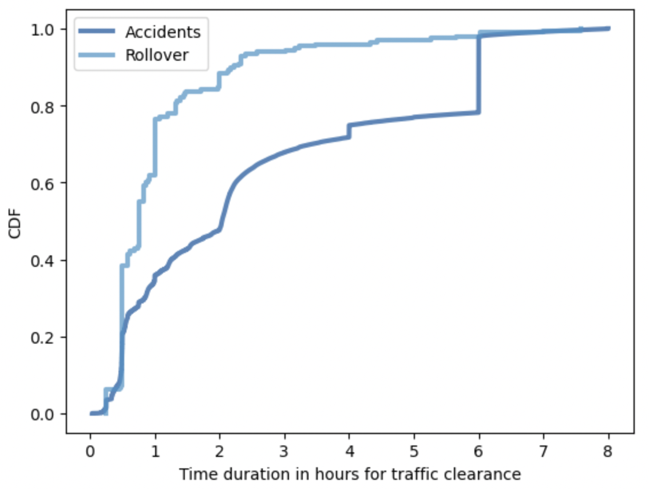
Question 6: Create 1 CDF with one of your variables, using page 41-44 as your guide, what does this tell you about your variable and how does it address the question you are trying to answer (Chapter 4)
Observation :
CDF plot compares probabilities of “time duration for clearance” of accident events vs rollover events.
At a very high level looking at CDF plot we can say that traffic due to rollovers were cleared much quickly than accident events.
We can see clearly that about 80% of rollover traffic cases were resolved in 1 hr. and about 90% in 2.5 to 3 hrs.
We can also see that about 70% of the accident cases took about 4 hrs., while 80% were cleared in about 6 hrs. and 90-100% by 7/7.5 hrs.
Conclusion based on sample at hand, accident cases took about 4 times the amount of time it took for rollover traffic cases to be cleared.

Slide 7
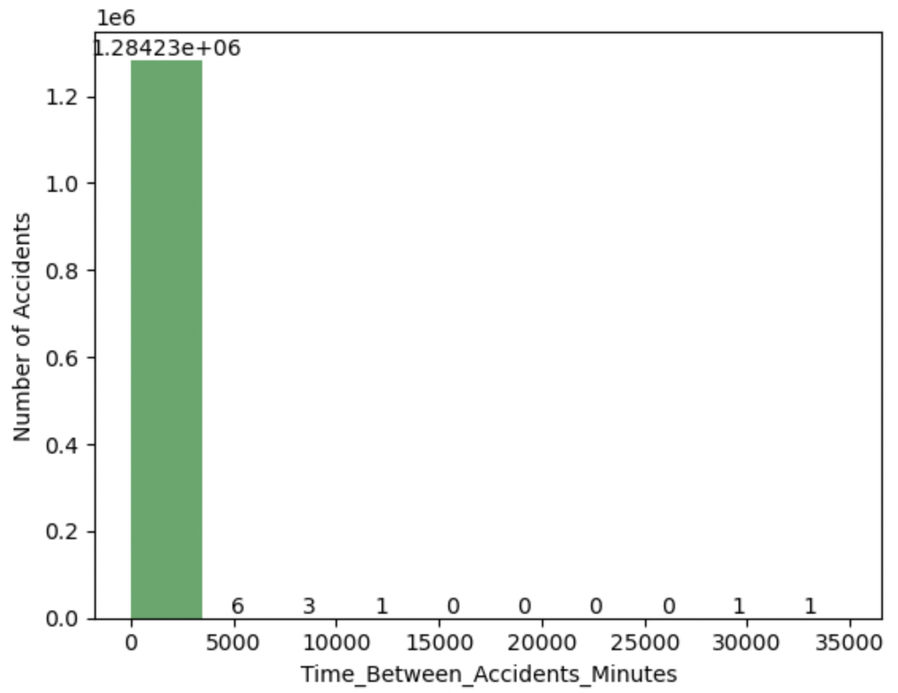
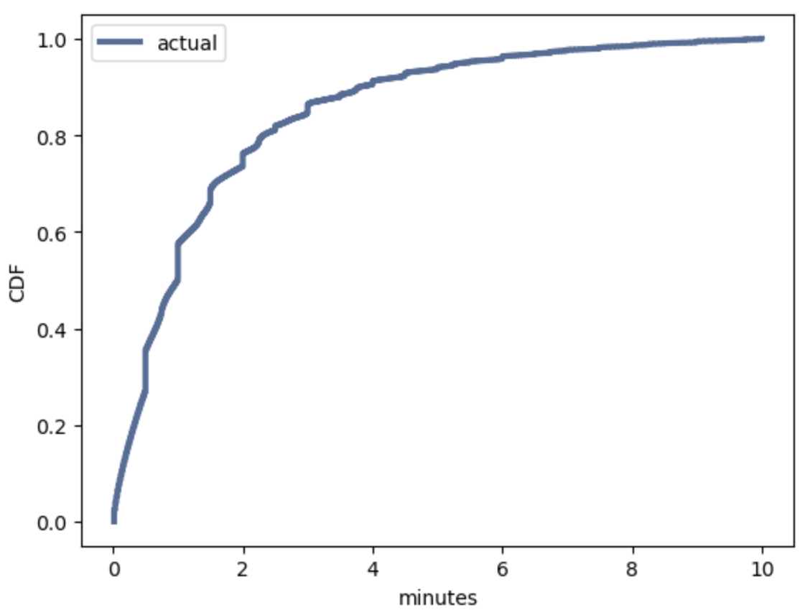
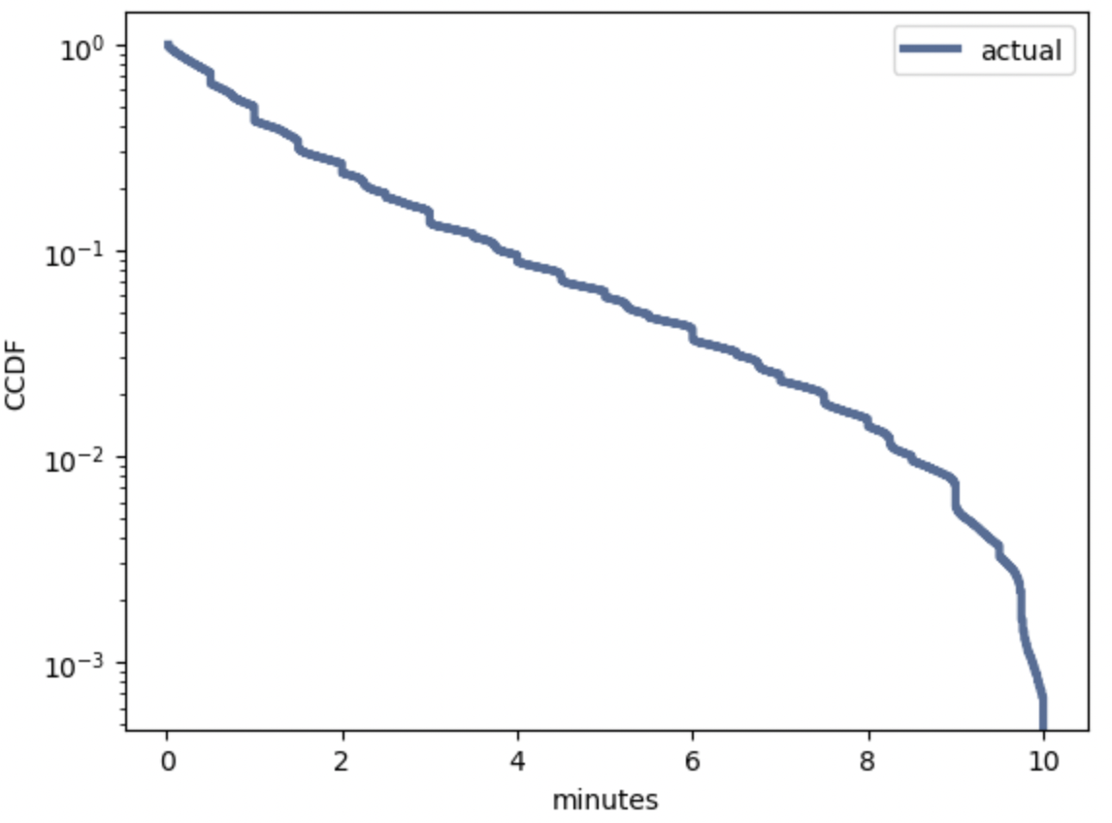
Question 7: Plot 1 analytical distribution and provide your analysis on how it applies to the dataset you have chosen (Chapter 5).
Hypothesis : Accidents can occur anytime and the time difference between accidents should be equally spaced. To proof the same, I have created a dataset with time differences and plotted an exponential distribution and have compared it with ideal exponential distribution's shape.
Observations:
Fig 1 : Clearly, we have outliers / edge cases which we should remove. We can see that 75% of the data has about 2.21 minutes as time diff between current and next accident. For plotting, filtered out the data with times diffs more than 10 minutes between two accidents.
Fig 2 : General shape of the cdf plot is exponential shape, in order to proof that data distribution is in fact exponential we can plot the complementary cdf on log y scale. This should be approximately straight line.
Fig 3: If we exactly remove some of the low frequency values beyond time diff of 2.5 minutes, we can further smooth out the line here, specially between 5 and 10, but almost a straight-line proofs that exponential distribution can be used to represent the time differences between two accidents.

Slide 8
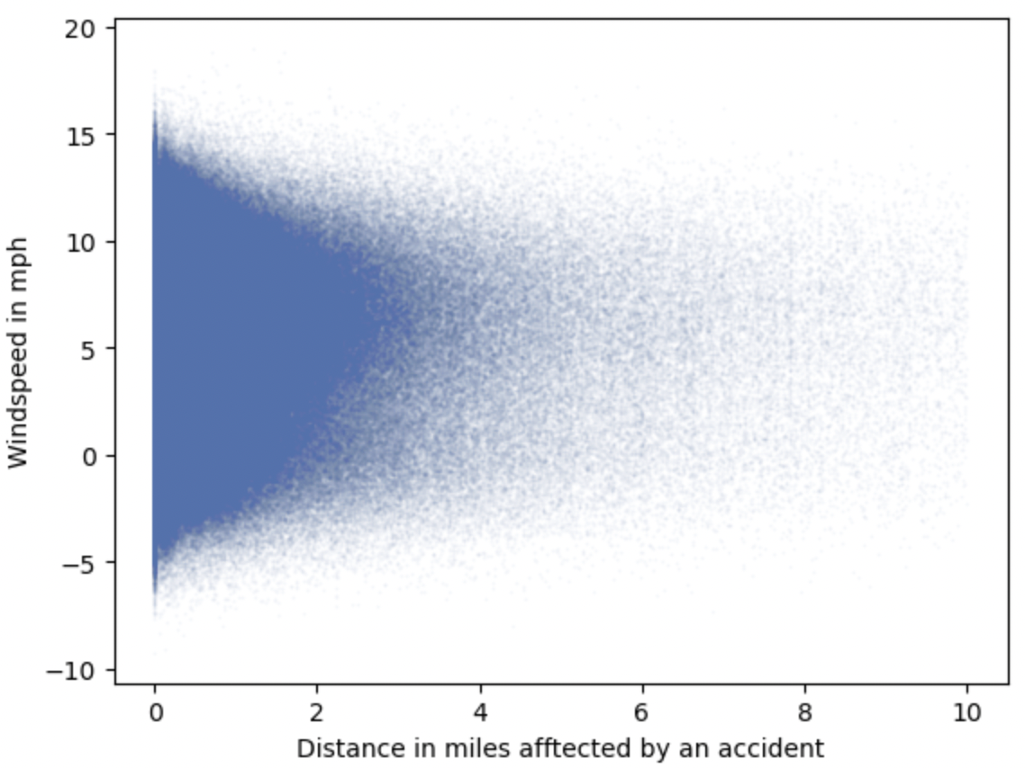
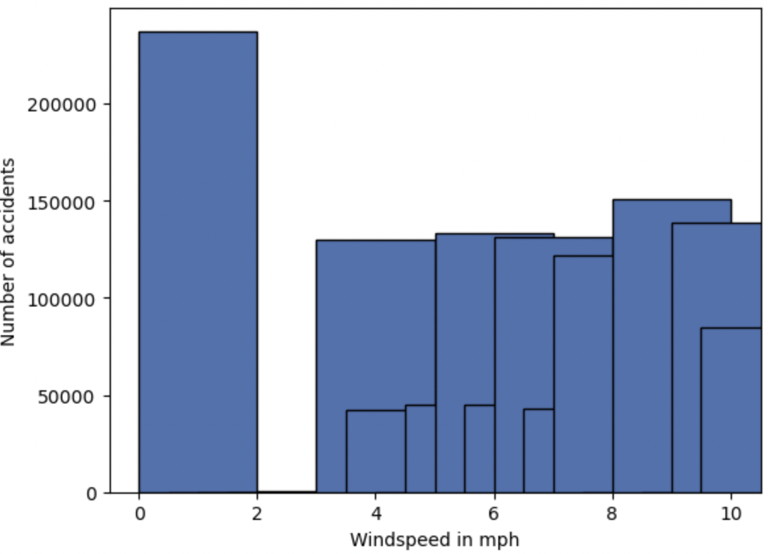
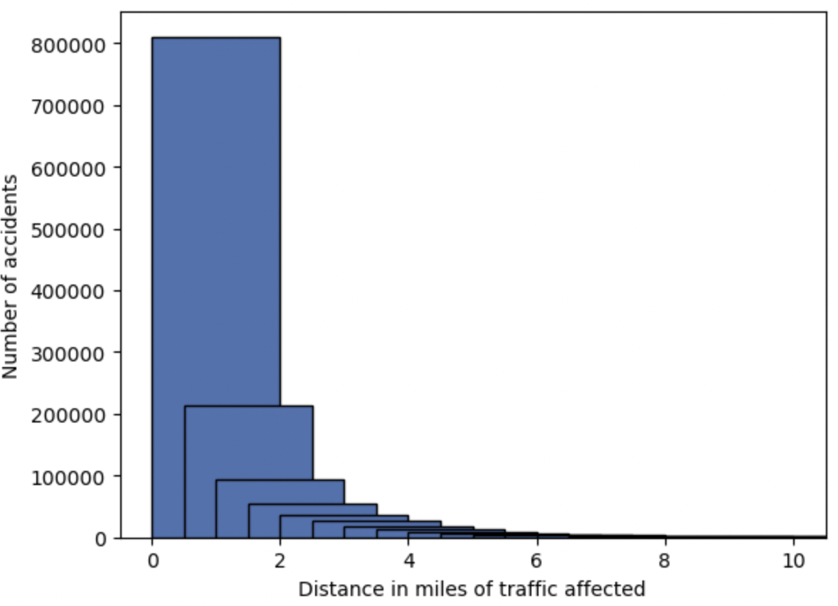
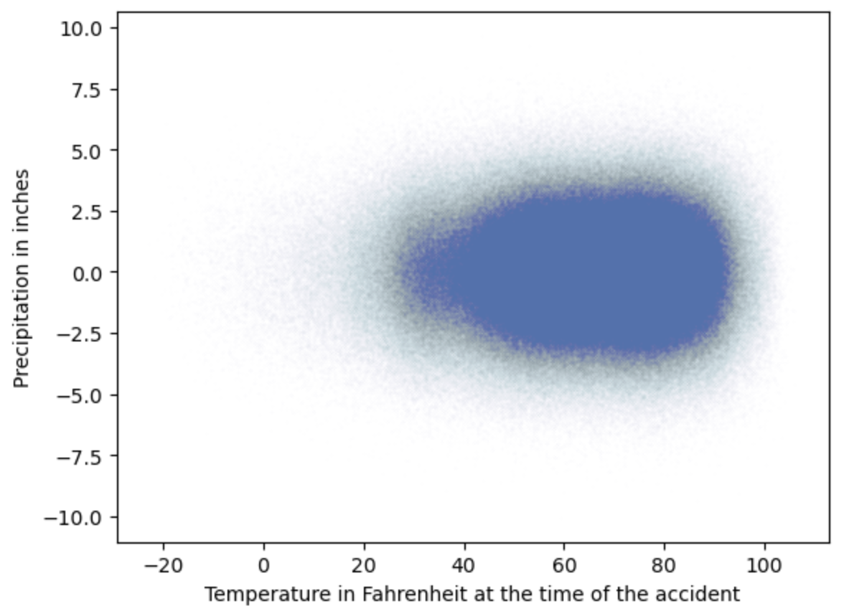
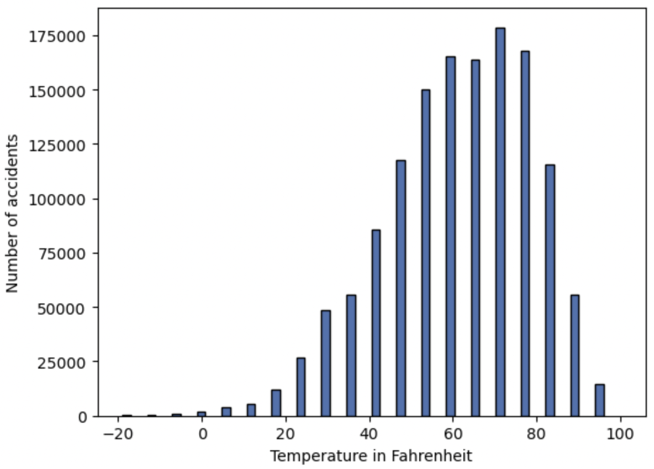
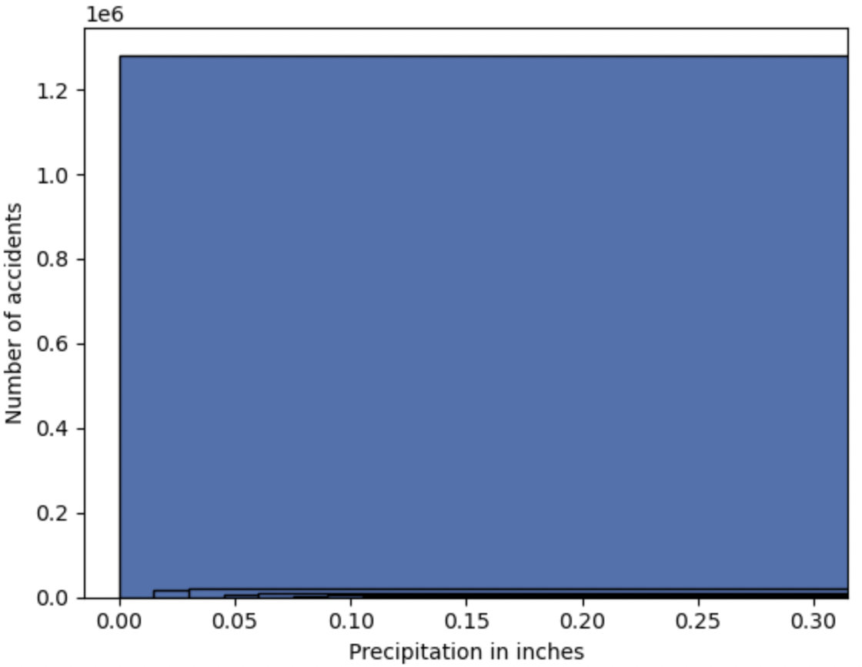
Question 8: Create two scatter plots comparing two variables and provide your analysis on correlation and causation. Remember, covariance, Pearson’s correlation, and Non-Linear Relationships should also be considered during your analysis (Chapter 7).
Plotting first scatter plot between Windspeed at the time accident event was logged and distance in miles i.e. traffic congestion in miles caused by traffic accident. There appears to very low positive correlation between distance and windspeed by looking at scatterplot.
Distribution of two variables is also not normal and thus Pearson's correlation coefficient cannot be taken seriously.
Plotting second scatter plot between Temperature at the time accident event was logged and precipitation in inches. There does not seem to be any obvious correlation.
Temperature spread seems nearly normal but discrete. Precipitation data seems to be uniformly distributed. We cannot consider the value of Pearson's correlation as data in precipitation is not normally distributed.

Slide 9
Question 9: Conduct a test on your hypothesis using one of the methods covered in Chapter 9.
Hypothesis : There exists difference between "time duration to clear the traffic" because of accident and in case of other road events i.e., rollover, road work etc.
Type of test : Two tail test
Test Statistic : Mean differences
Other choice of test : Chi square test
Test Result is highly significant with p-value near 0 in all 7 iterations. Even with low number of records passed to the test, statistical significance is high and thus we can easily reject the null hypothesis to proof that there exists difference between "time duration to clear the traffic" because of accident and in case of other road events i.e., rollover, road work etc.
Iteration no | No of Records | P-value of mean diff comparison | P-value of mean diff with no nulls comparison | P-value of chi-squared test
1 | 2845342 | 0.00 | 0.00 | 0.00
2 | 1422671 | 0.00 | 0.00 | 0.00
3 | 711335 | 0.00 | 0.00 | 0.00
4 | 355667 | 0.00 | 0.00 | 0.00
5 | 177833 | 0.00 | 0.00 | 0.00
6 | 88916 | 0.00 | 0.00 | 0.00
7 | 44458 | 0.00 | 0.00 | 0.00

Slide 10
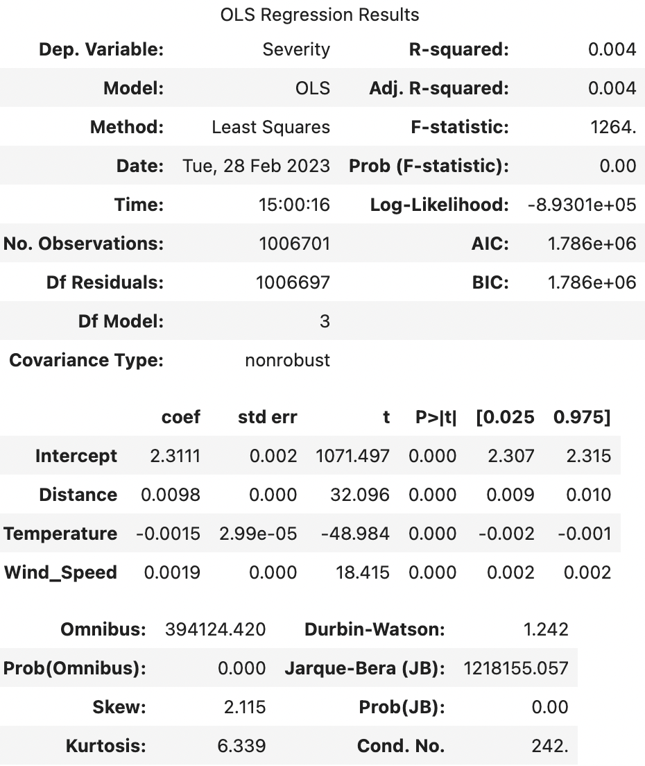
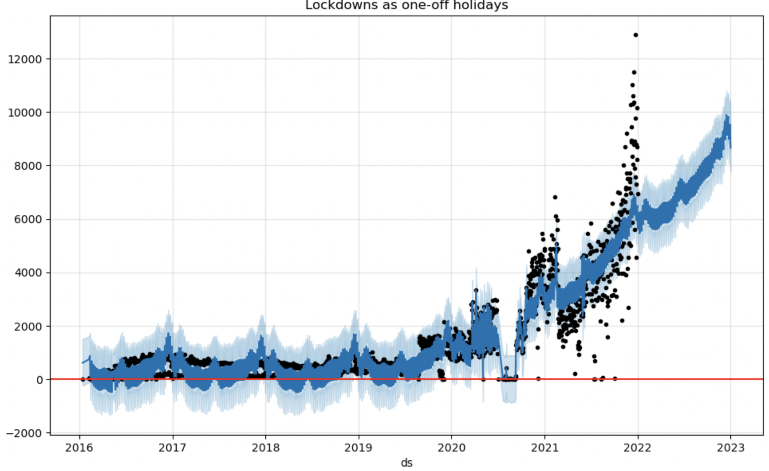
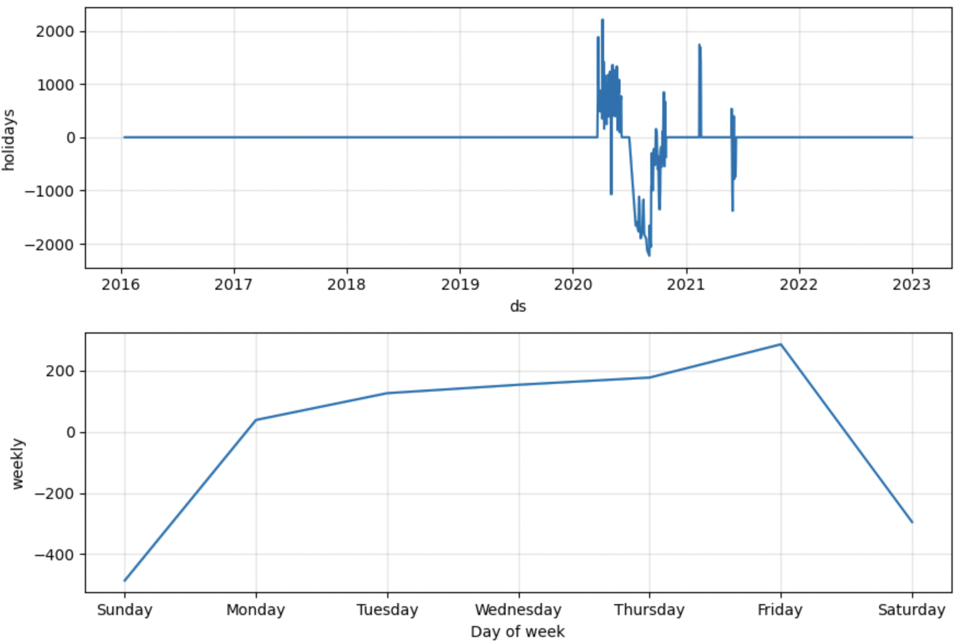
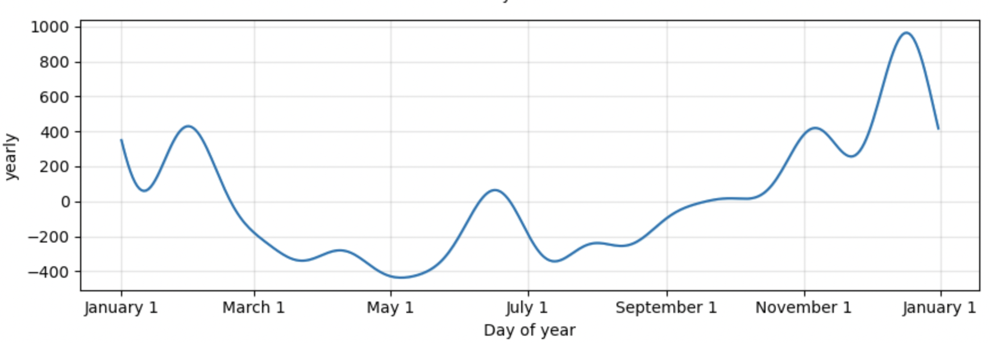
Question 10: For this project, conduct a regression analysis on either one dependent and one explanatory variable, or multiple explanatory variables (Chapter 10 & 11).
Two regression analysis I ran are below –
Predicting severity of the accident from "Distance(mi)”, "Temperature in F”, and "Windspeed in mph”.
Using timeseries analysis - looking at the number of accident prediction for 2022 and 2023, YOY comparison, and weekly and monthly seasonality.
Overall trends are predicted to go up for traffic events in 2022 and later from ~4,000 to ~6,000 at the start 2022 when compared to start of 2021.
Prediction is continuous increasing trend in 2022, with 2022 ending with about 90 to 100,000 traffic events. Did consider COVID 19 lockdowns as holidays when creating above prediction.
It's clear that we have seasonality in the data, and it is influenced by national holidays and summer vacations. We can see the traffic events spike towards the end of the year starting from Thanksgiving going into New year.
We can also see traffic events spike during summer vacations showing that's when people travel more. Take away will be to avoid travel during identified busy months / seasons.
Looking at the r-squared of model which near 0, it does not represent strong relationship between independent and dependent variables. Individually though p-values of independent variables is quite significant

Slide 11
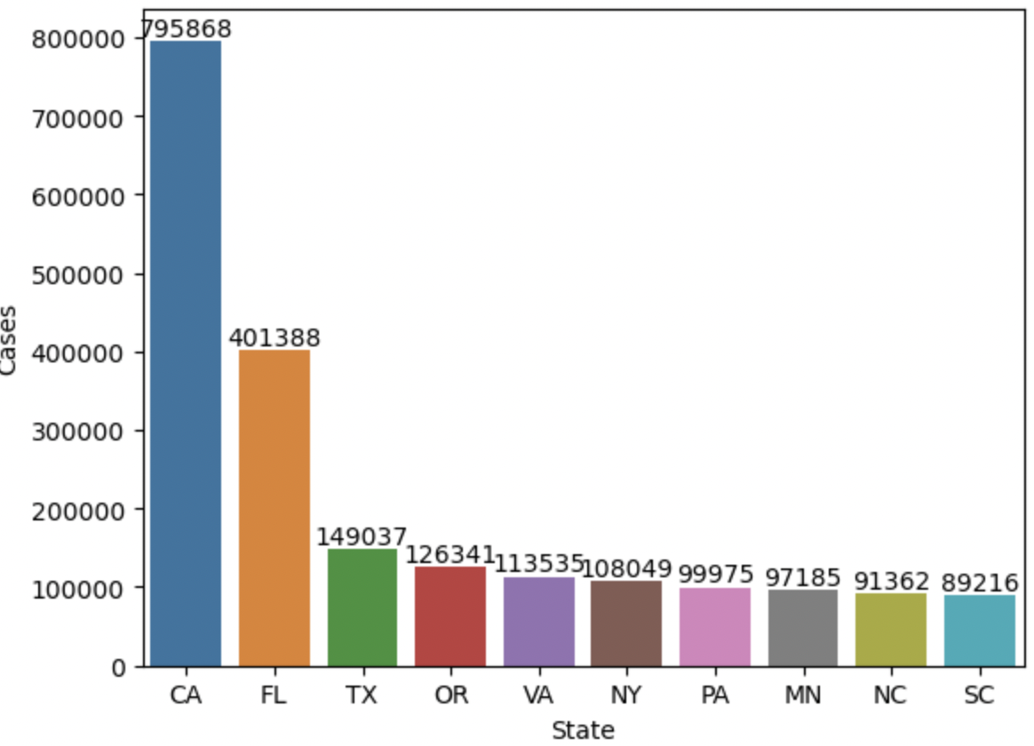
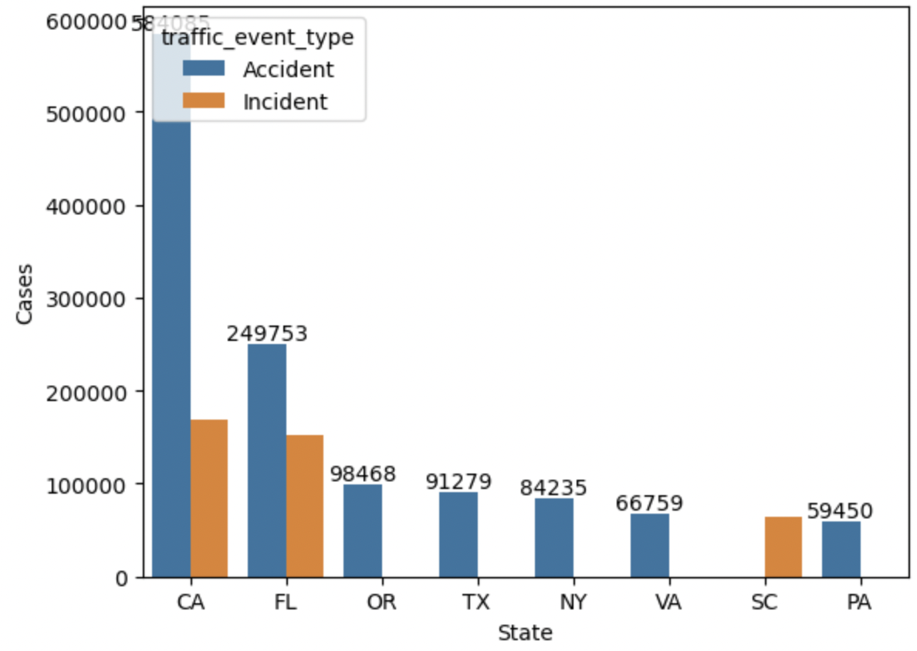
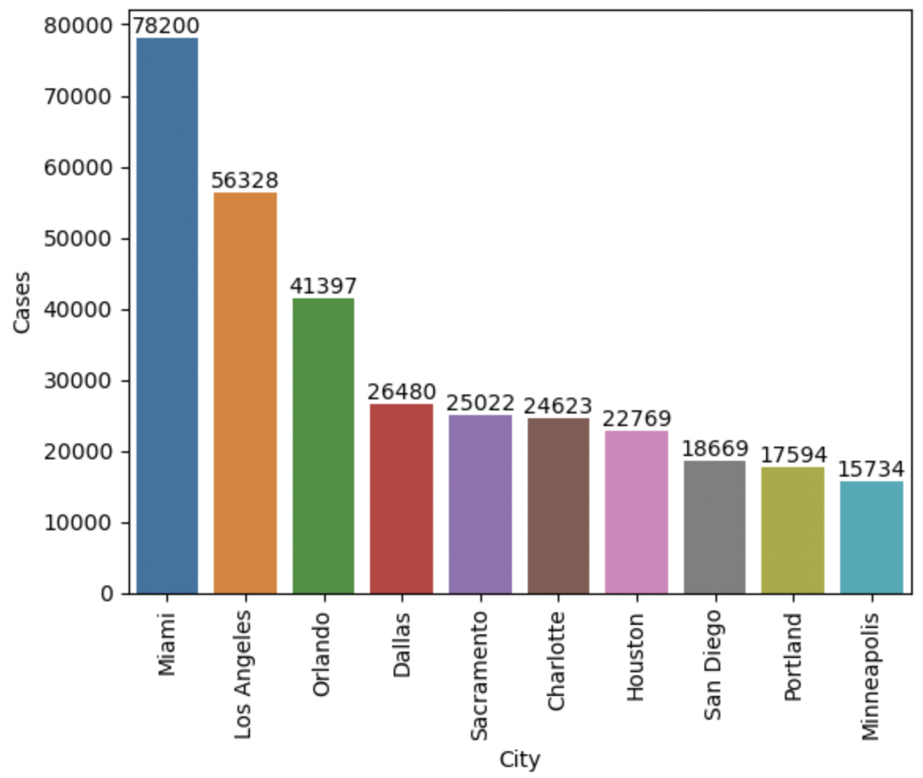
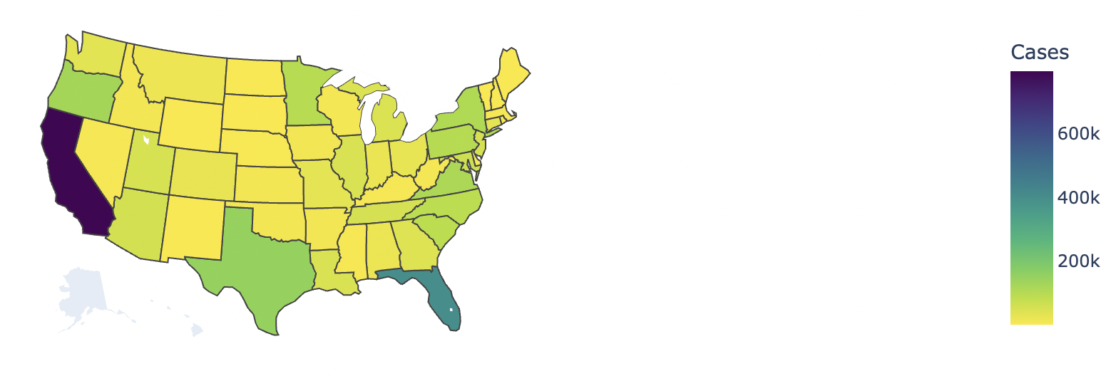
Location Analysis In this dataset, we have different attributes like city, state, time zone and even street for each accident records. Here we will analyze these four features based on the no. of cases for each distinct location.
Fig 1: CA had highest no of accidents, about 800K while next state was FL with ½ the cases i.e., 400K. Checked for accidents vs other traffic incidents by state in Fig 2.
Fig 3 : Shows traffic cases distribution by cities. Miami is leading with 78200 followed by LA, Orlando, Dallas, Sacramento, Charlotte, Houston, San Diego, Portland, and Minneapolis.
Fig 4: Shows the distribution of traffic events (including accidents and others) by state on geo map of the US.

Slide 12
EDA SUMMARY
Outcome :
This is a countrywide traffic accident dataset, which covers 49 states of the United States. Below are all EDA outcomes and observations.
1. Only 10-15% of all accidents in the US were high severity accidents.
2. More than 80% of the accidents impacted less than 1 mile and got cleared in less than 7 hrs.
3. 50% accident happened at temperature between 55-to-80-degree Fahrenheit.
4. More than 80% of accidents seems to have happened at windspeed <= 11 mph
5. Low to medium severity accidents have slightly higher probability of occurrence during nighttime. And higher severity accidents have higher probability to occur in daytime. Severity 4 accidents have almost 10% probability of happening in daytime while only about 6% probability of them happening at the nighttime.
6. LOCATION Analysis - Accidents are concentrated in western and eastern US states. Minimal accident events were recorded in the central US. Top 10 states with highest number of accidents are CA, FL, TX, OR, VA, NY, PA, MN, NC, SC from highest to lowest respectively. Miami, Los Angeles, and Orlando are top 3 cities with accidents.
7. In about 70% of accidents traffic cleared within 4 hrs. 80% rollovers were cleared within an hour.
8. TIME SERIES ANALYSIS - Prediction for year 2022 and 2023 shows increasing number of accidents by almost 40% between start of 2022 and start of 2023.
9. SEASONALITY - Accident data has seasonal trend and spikes during holidays (specially between Nov to Jan) and in summer vacations.
What is missing in the data?
I think info about types of car involved in the accidents, number of people involved, gender, student driver or not etc wil be very interesting
to look at as well.
Were there any variables you felt could have helped in the analysis?
Some variables that are present, but I did not look at them are binary variables showing details about surroundings of the accident i.e. presence of sppek breaker, signal etc.
Were there any assumptions made you felt were incorrect?
Assumptions related to accidents during daytime and nighttime needs more data.
What challenges did you face, what did you not fully understand?
Regression analysis to predict severity of an accident by distance, temperature etc. was not accurate. Model was not very accurate with low R-squared but individual independent variables showed statistically significant p-values.

